Slide 1
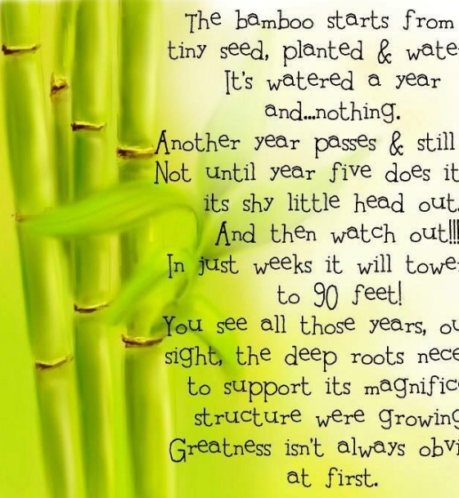
Do you know how long it takes for the Giant Bamboo to grow as tall as a building?
Growth takes patience & perseverance…

Slide 2
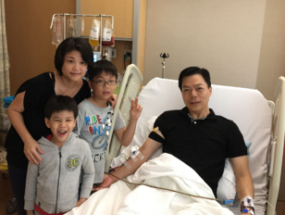
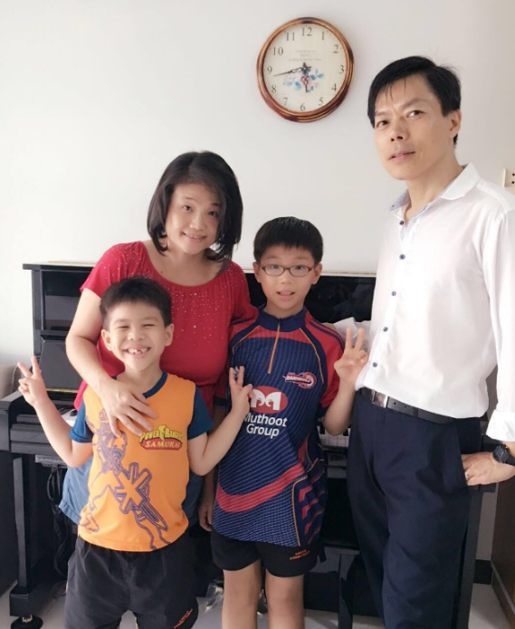
Our Isotonix products has helped my husband to recover well after the Bone Marrow Donation.

Slide 3
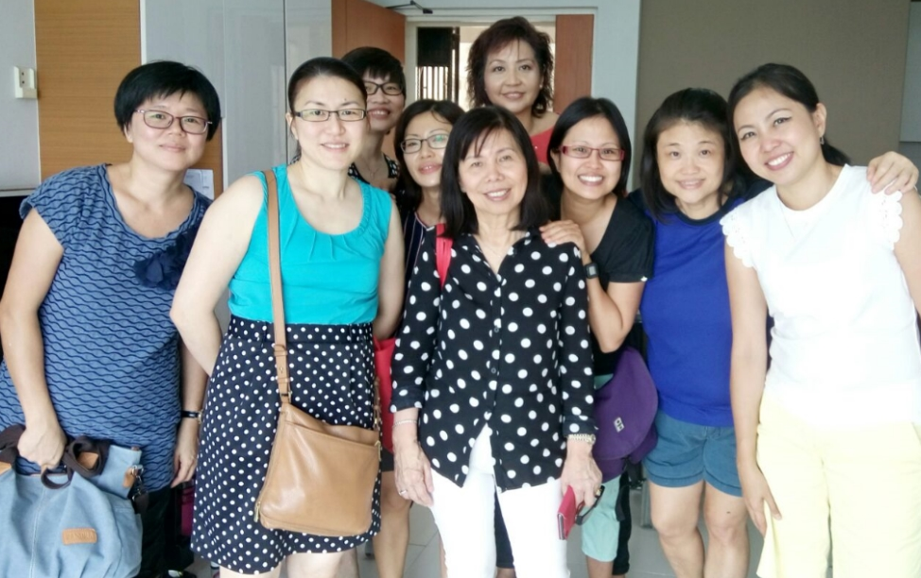
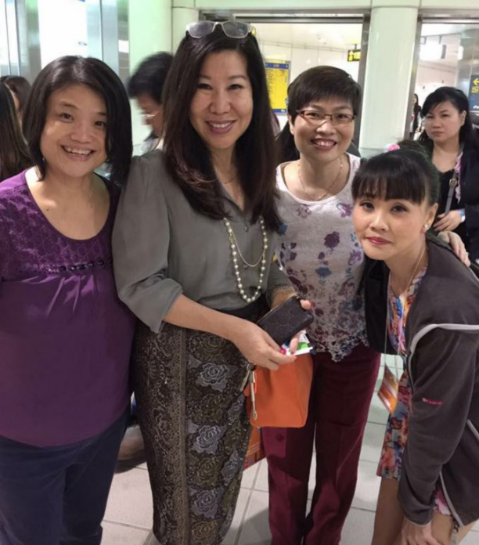
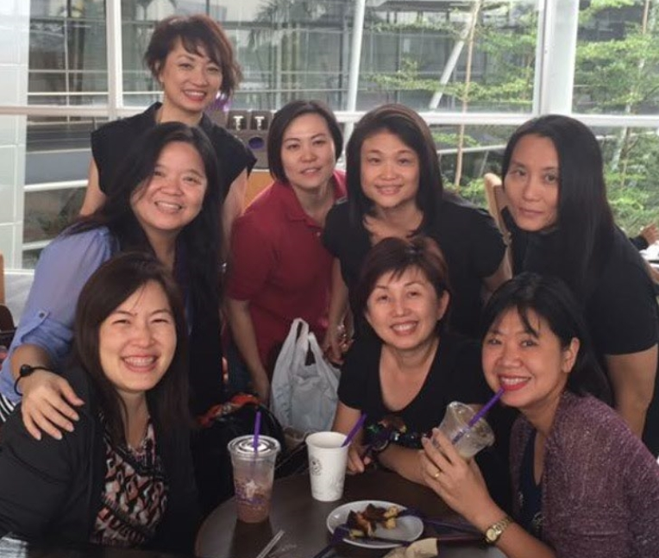
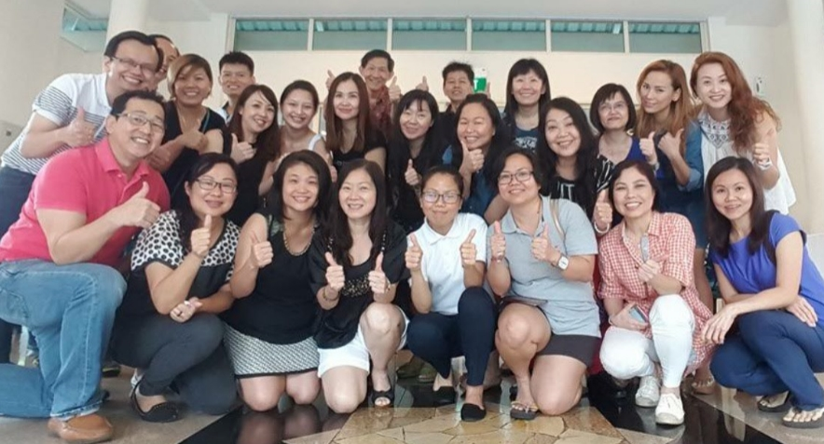
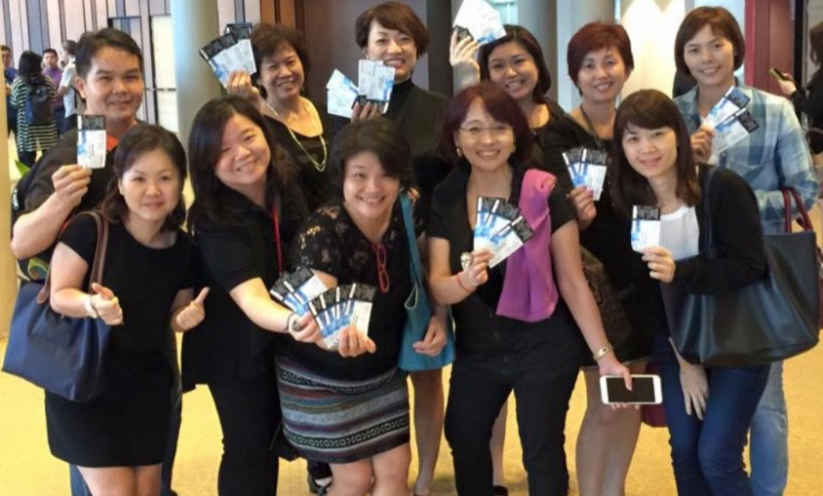

Slide 4
DREAM
comes true…
D are to dream
R oad to success
E xcel as a team
A lways believe
M ake it happen

